Slide 1

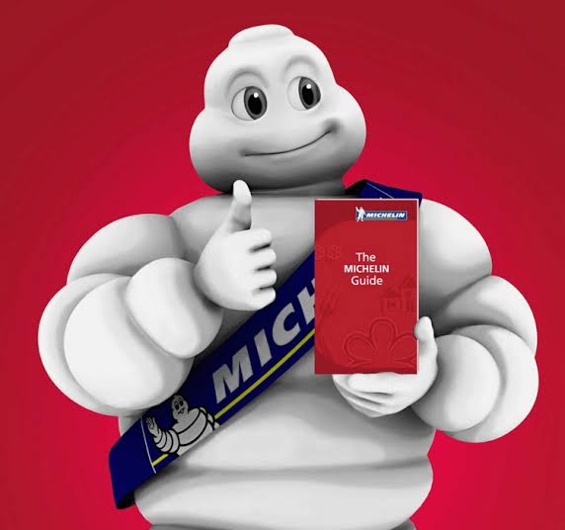
MICHELIN GUIDE
CASE STUDY BY-
PARCHMENT NOT PAPER

Slide 2

ABOUT
Michelin Guides are a series of guide books published by the French tyre company Michelin for more than a century.
The term normally refers to the annually published Michelin Red Guide, the oldest European hotel and restaurant reference guide, which awards up to three Michelin stars for excellence to a select few establishments.

Slide 3
To increase the demand for car tires, car tire manufacturers and brothers Édouard and André Michelin published a guide for French motorists, the Michelin Guide.
Nearly 35,000 copies of this first, free edition of the guide were distributed; it provided useful information to motorists, such as maps, hotels, and petrol stations throughout France.

Slide 4

SERVICE PROVIDED
Restaurant Booking
Hotel Booking
Magazine Articles
Stories shared by Chefs
Event details by Michelin

Slide 5
TO ENTER INTO MICHELIN GUIDE-
URL-
https://guide.michelin.com/en

Slide 6
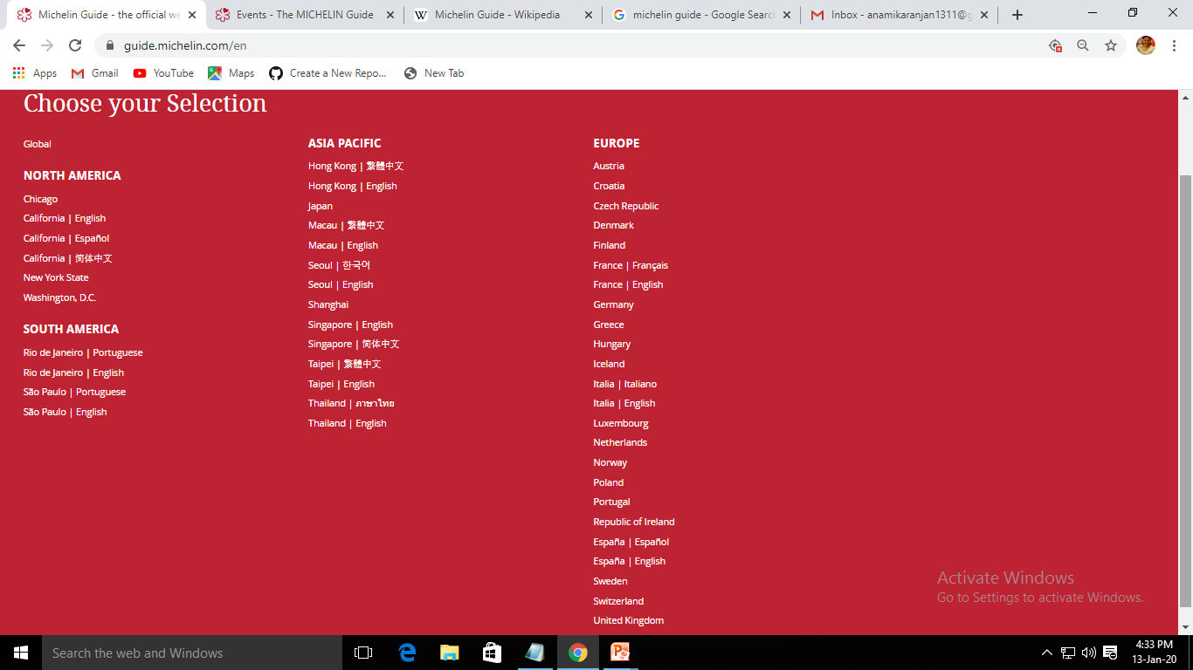
Selection of Countries and Languages

Slide 7
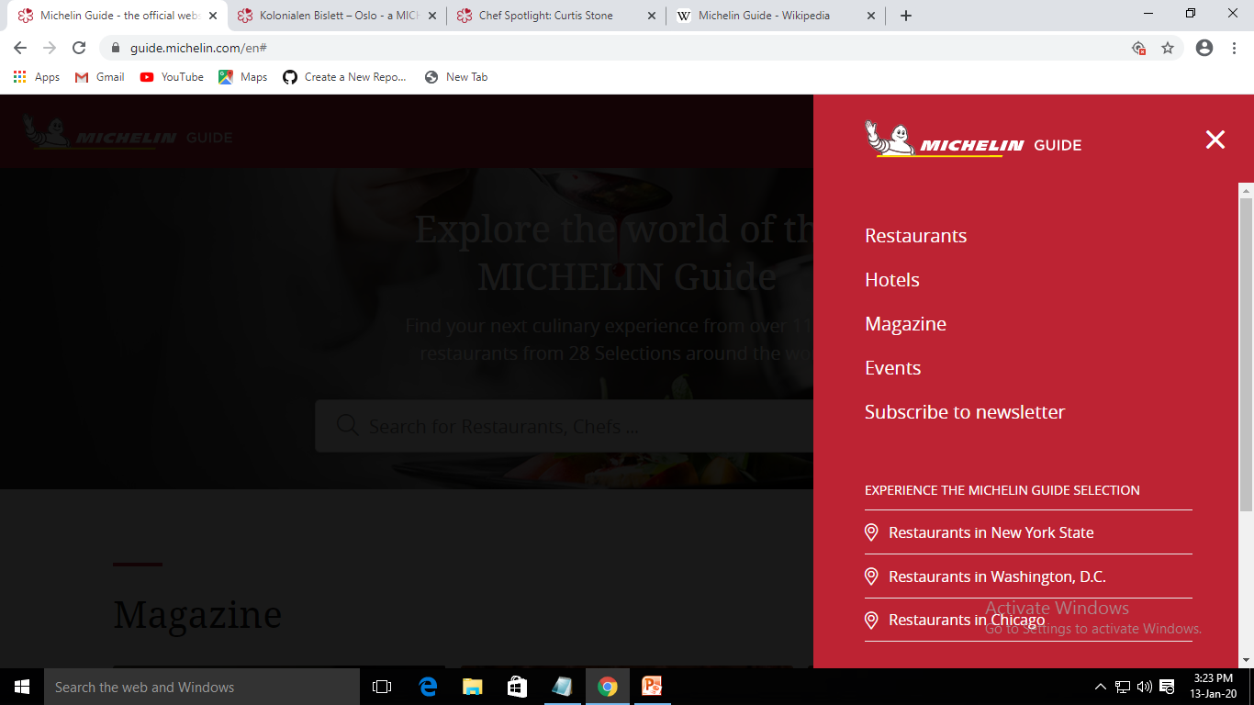
HOME PAGE- Options Available

Slide 8
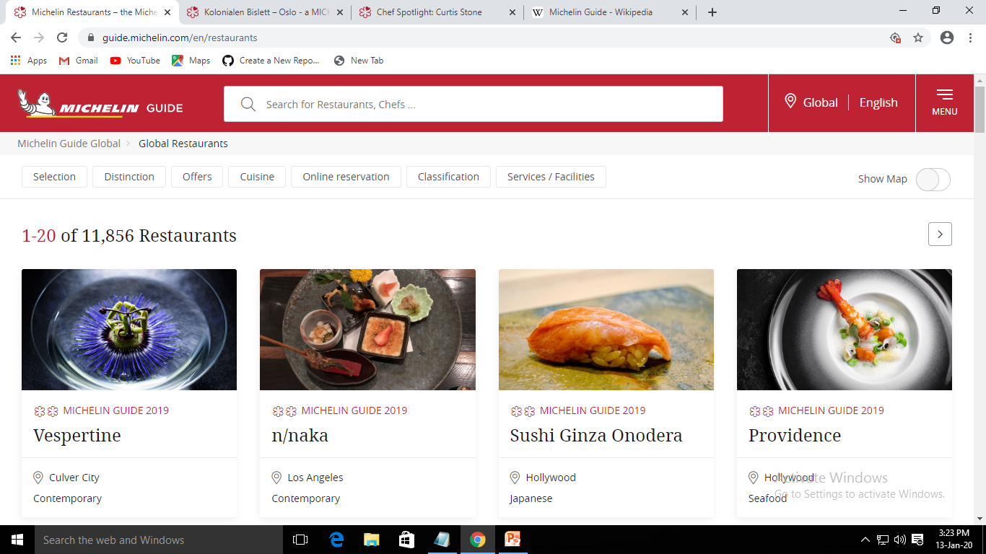
Restaurants

Slide 9
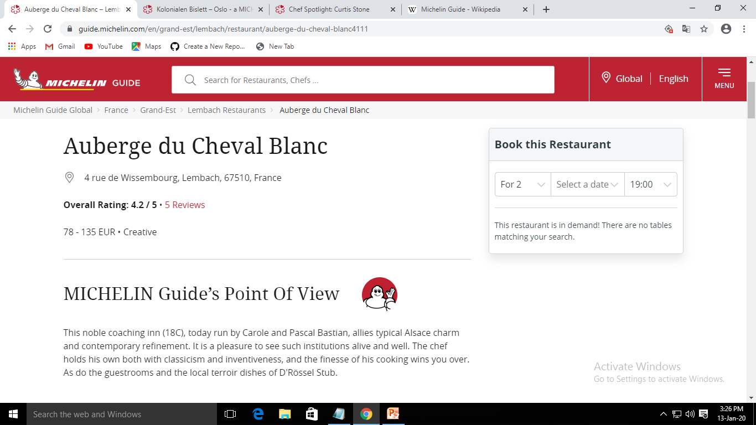
About the chosen restaurant

Slide 10
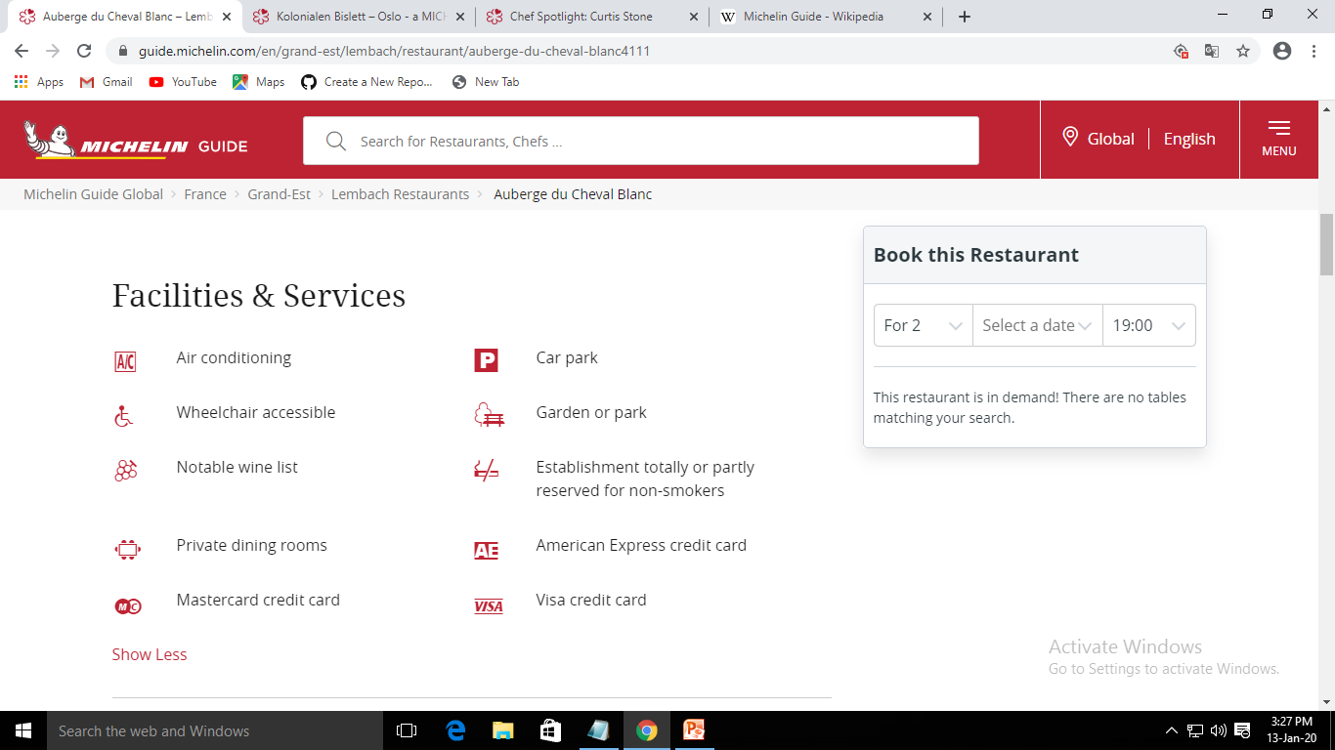
Facilities and services available

Slide 11
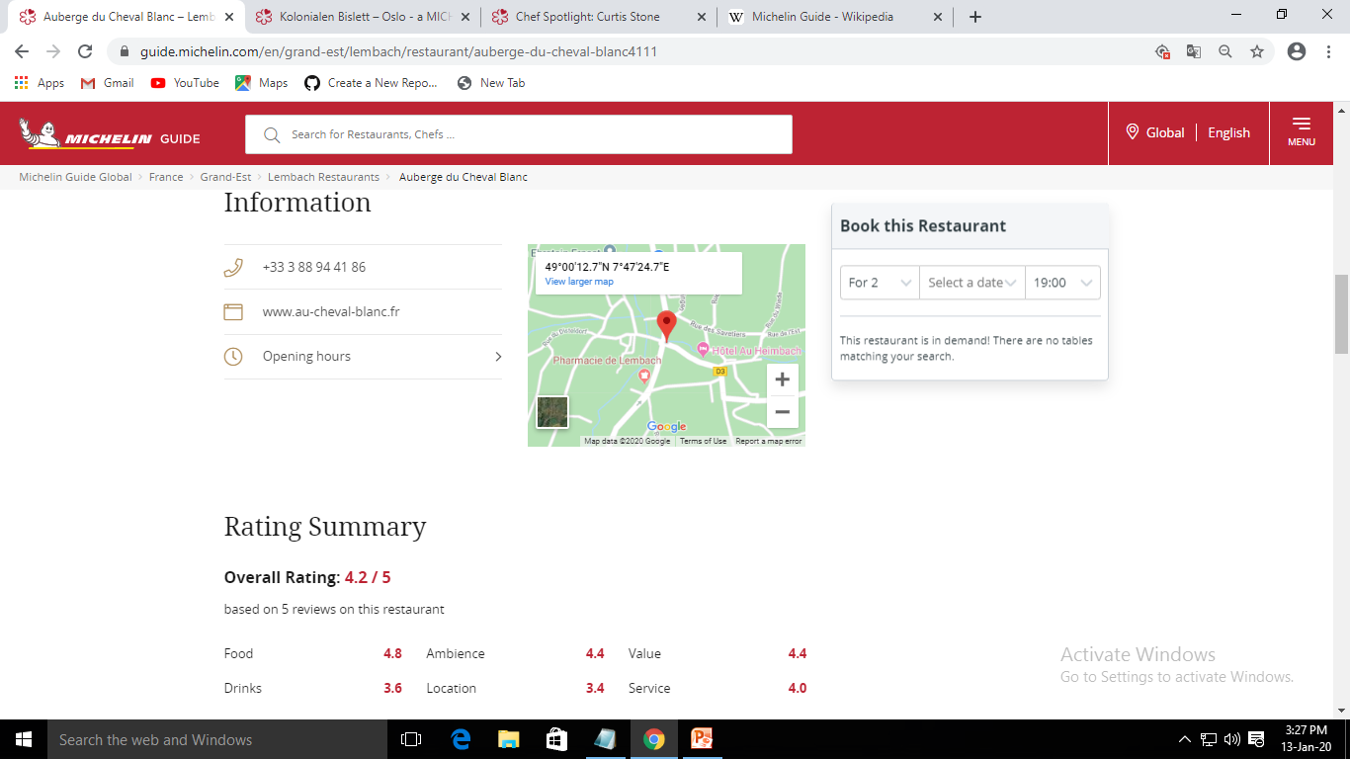
Details before booking

Slide 12
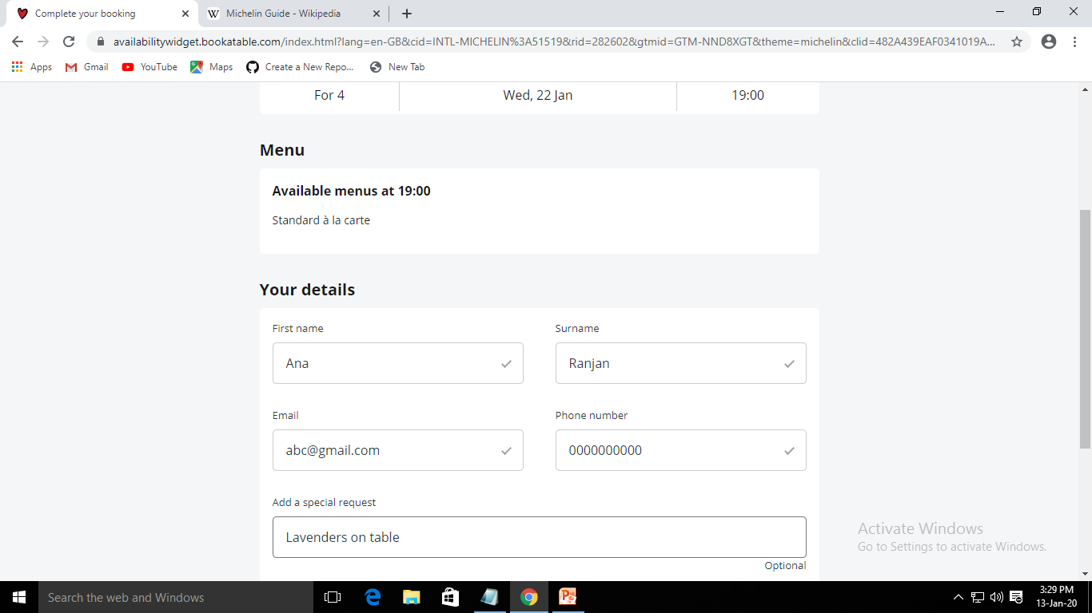
Details to be entered

Slide 13
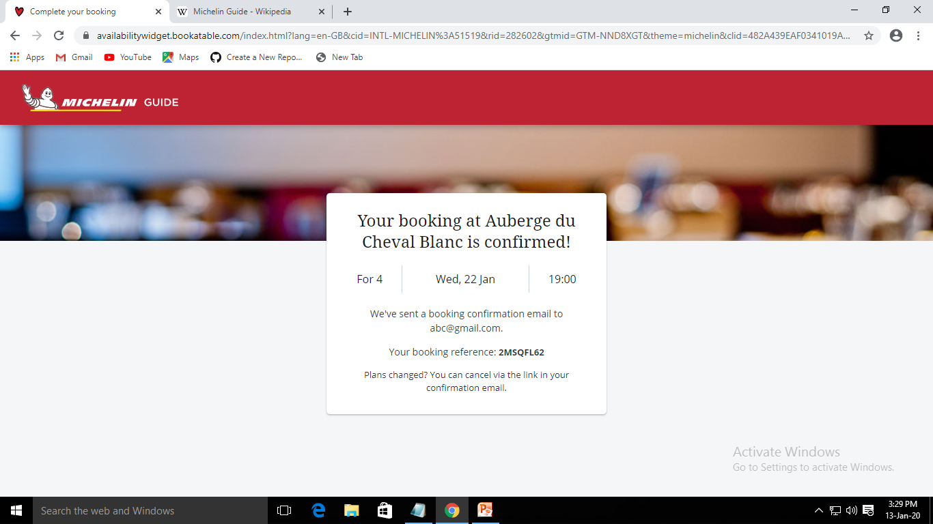
Booking Confirmation

Slide 14
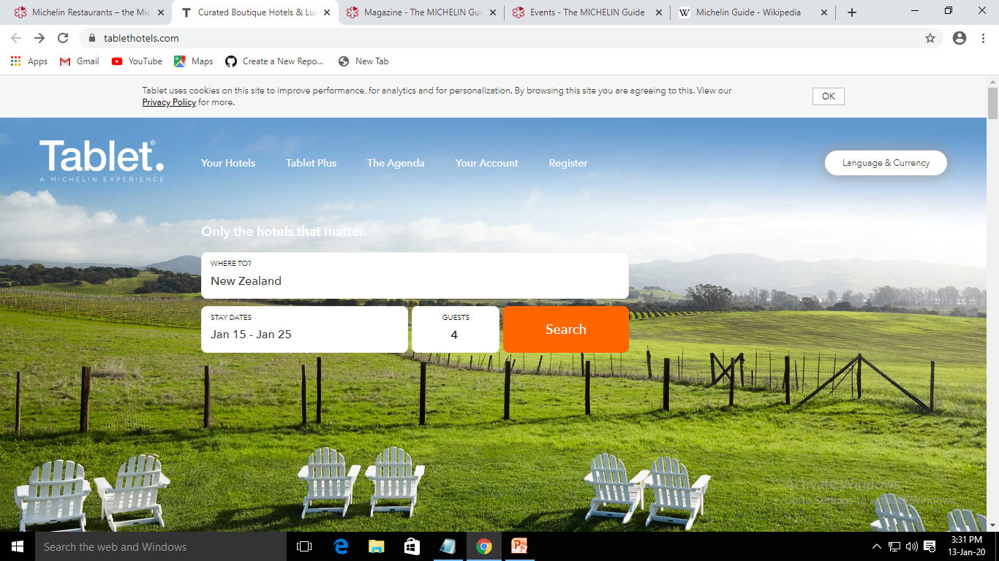
Hotel Booking Facility

Slide 15
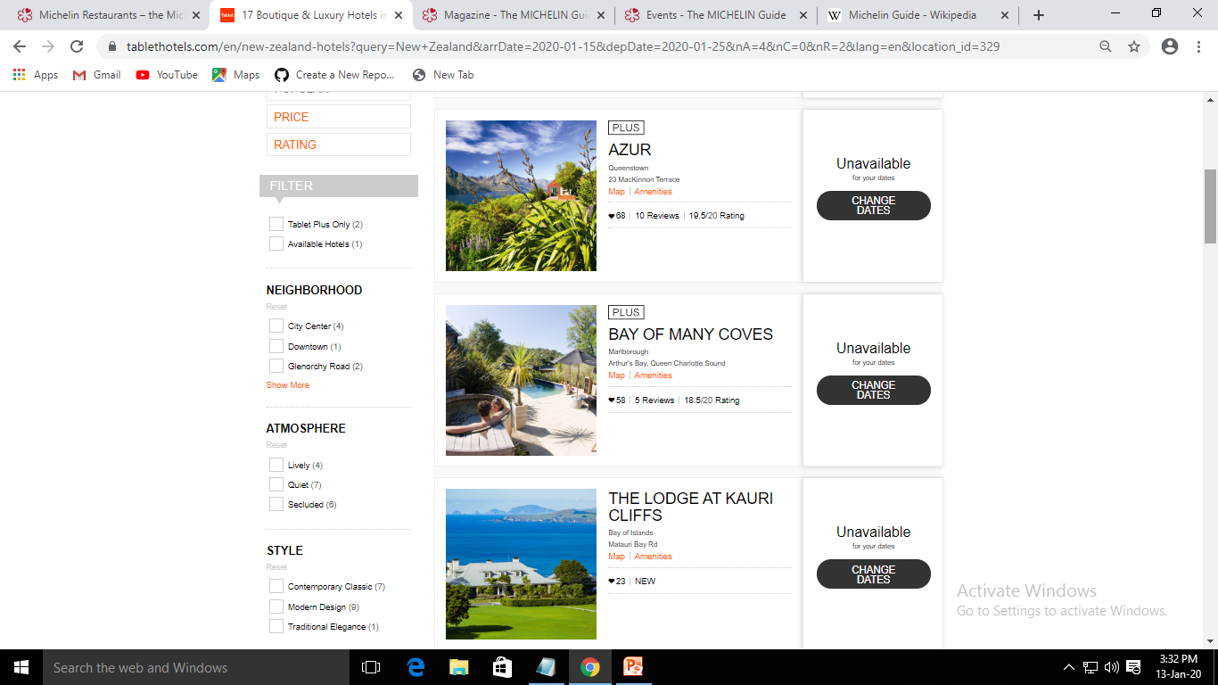
Hotel Options

Slide 16
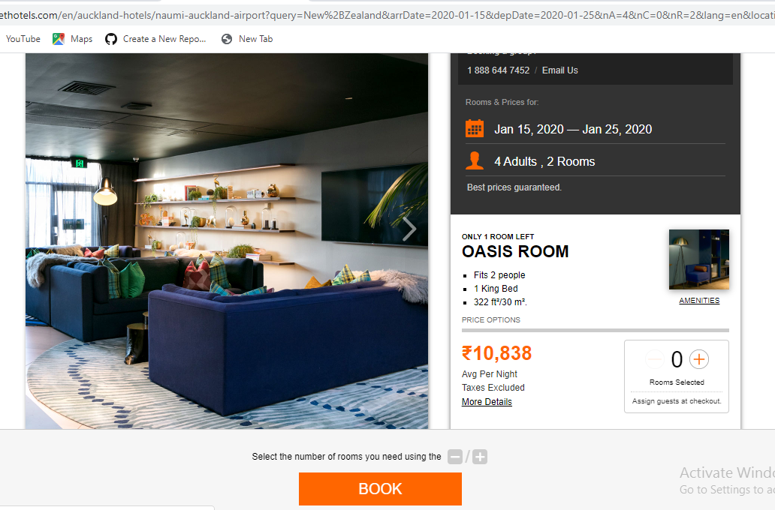
Booking details & Confirmation

Slide 17
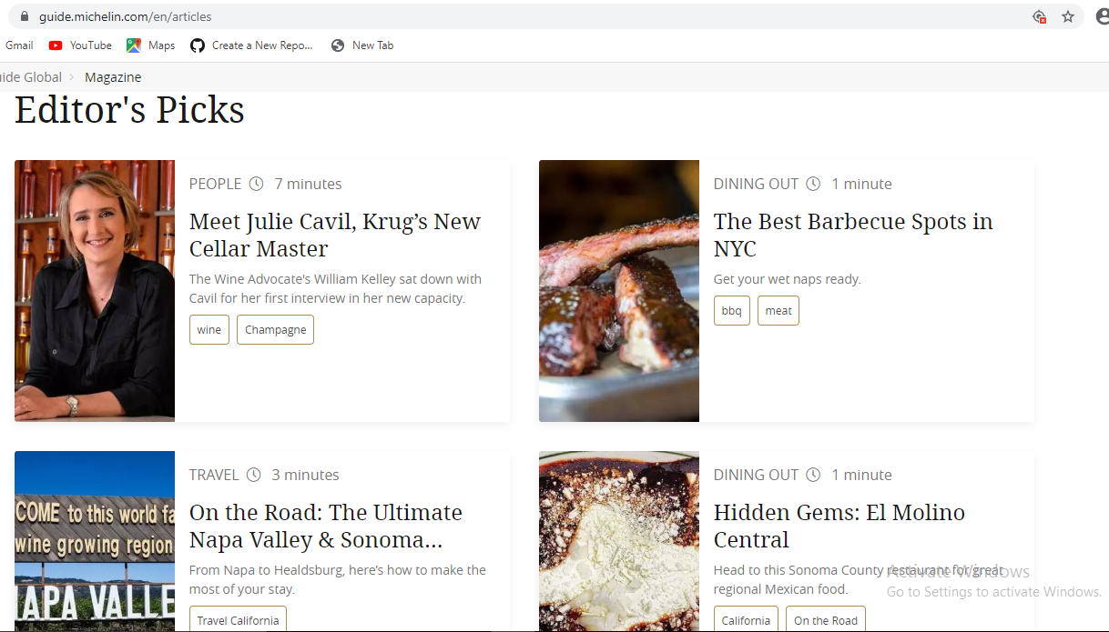
Magazine and Story Selections

Slide 18
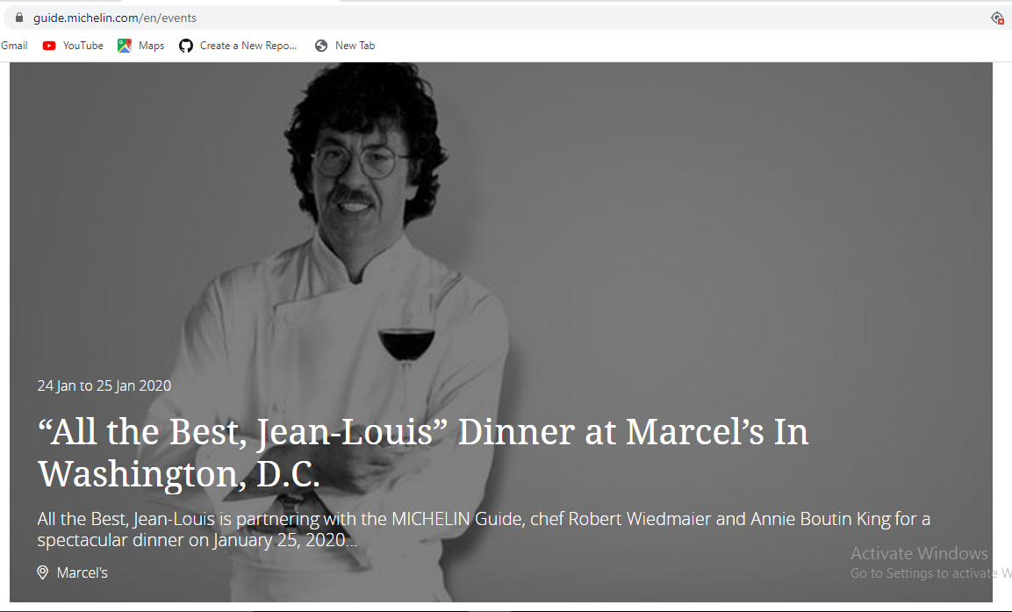
Event Option

Slide 19


